Slide 1

LAW FIRM MANAGEMENT SYSTEM
CAPSTONE PROJECT DEFENSE CEREMONY

Slide 2
TEAM 14
SUPERVISOR:
TEAM MEMBERS:
LAM HUU KHANH PHUONG
NGUYEN THE VINH
NGUYEN TIEN THANH
NGUYEN THANH SANG
LE DUY HOANG

Slide 3

CONTENTS
REQUIREMENT
DEMO
01 REQUIREMENT
02 PROBLEM
03 SOLUTION
04 PROJECT
05 DEMO
PROJECT
PROBLEM
SOLUTION

Slide 4

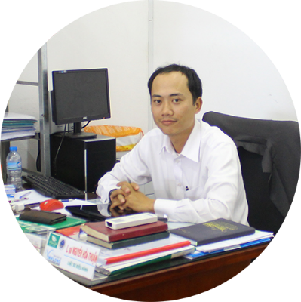
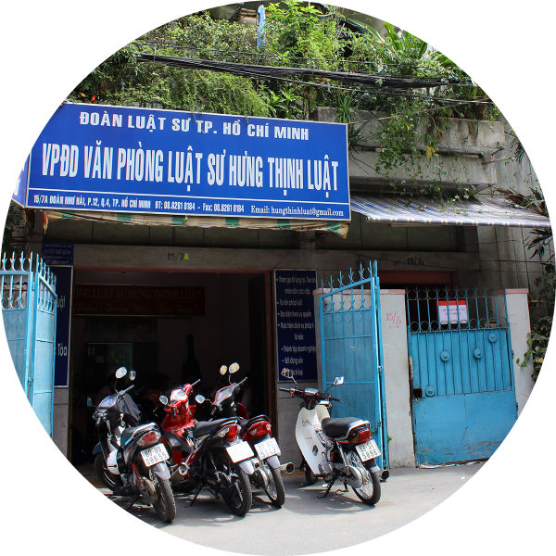
REQUIREMENT
Manager of

Slide 5
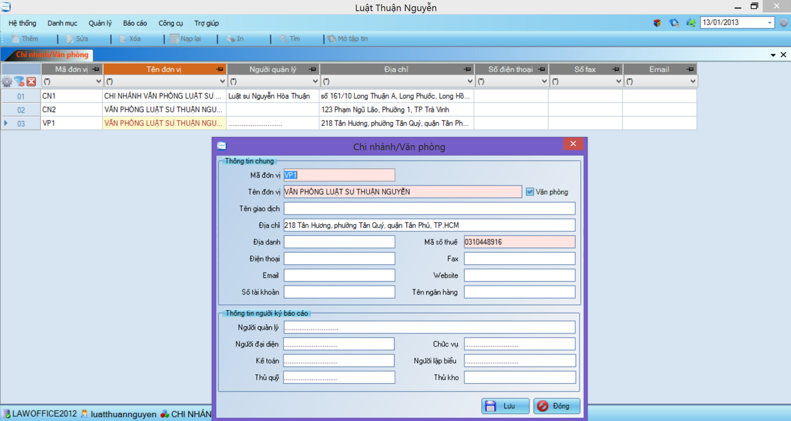
PROBLEM / Current System

Slide 6





PROBLEM / Current System
Many errors occur
Difficult to upgrade or maintain
Limit number of devices can use
Manage only 1 office
Manage with only text information

Slide 7

SOLUTION / LFMS
Steady running
Easy upgrade and maintenance
Multiple devices can use at the same time
Can be used for many types of office
Manage multimedia data

Slide 8









PROJECT / Tools and Techniques

Slide 9
PROJECT / MVC Architectural Design

Slide 10


PROJECT / Future Plan
Use Android App
To Locate by GPS

Slide 11
PROJECT / User Role
Admin
Creator
Viewer

Slide 12
PROJECT / Functional Requirement
LFMS
Manage Office
Manage Staff
Manage Service
Manage Customer
Manage Case
Manage Calendar Event
Manage Case Info
Manage Operation Event
Manage People Related
Manage Document Related
Manage Invoice
Integrate Thu Vien Phap Luat

Slide 13
PROJECT / Core Flow
Add New Case
Assign Lawyer
Update Case Detail

Slide 14
DEMO
LFMS
DEMONSTRATION

